Slide 1
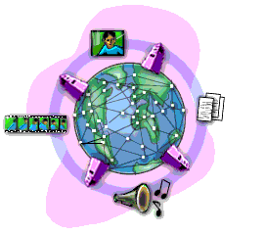
Internet Options
  By OTX-West

Slide 2
Discussion Points
Technologies
Dial-Up
DSL
Cable
Data Transfer Speeds
1 Kbps (Kilobit per second) = one thousand bits per second
1 Mbps (Megabit per second) = one millions of per second

Slide 3
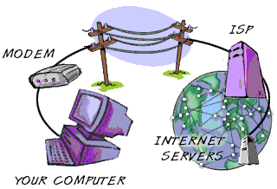
Dial-up Internet
Uses a 56k modem and a phone line
Cannot talk on the phone and be on the Internet at the same time
Speeds up to 56 Kbps
Web pages load slowly, email will be slow with large files
Disconnects after a few hours
Price varies from $7.00 (Californian.com) up to $23.95
Available to everyone with a phone line

Slide 4
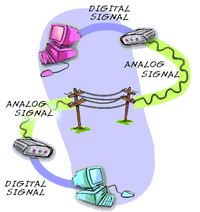
DSL Internet
Connects through a DSL modem, Network card and a phone line
Can talk on the phone and be online at the same time
Router connects multiple computers to 1 Internet connection
“Always on” connection
Speeds from 128 Kbps to 3 Mbps. DSL is typically limited to 128 Kbps upload speeds
Price varies from $12.95 (promotion) up to $50
California.com is $19.99 with no contracts or price increases
Installation and equipment fees may apply
Service not available in all areas

Slide 5
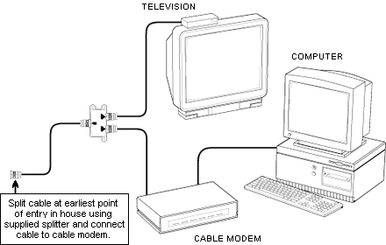
Cable Internet
Connects through a Cable modem over cable system
Cable TV subscription not required for cable Internet subscription
Router connects multiple computers to 1 Internet connection
“Always on” connection
Speeds up to 30 Mbps downstream (average rate around 500 to 700 Kbps downstream and 128 Kbps upstream)
Price varies from $19.99 (promotional price) up to $60
Installation and equipment fees may apply
Service not available all areas

Slide 6
Conclusion
Decide which option will meet your needs.
Shop around!
Ask questions and read everything before you sign up!
The End

